Slide 1
BPMN Fundamentals: BPMN Guide and Examples

Slide 2
5. BPMN Quick Guide and Examples
2

Slide 3
5.1 Bizagi BPMN Guide
3

Slide 4
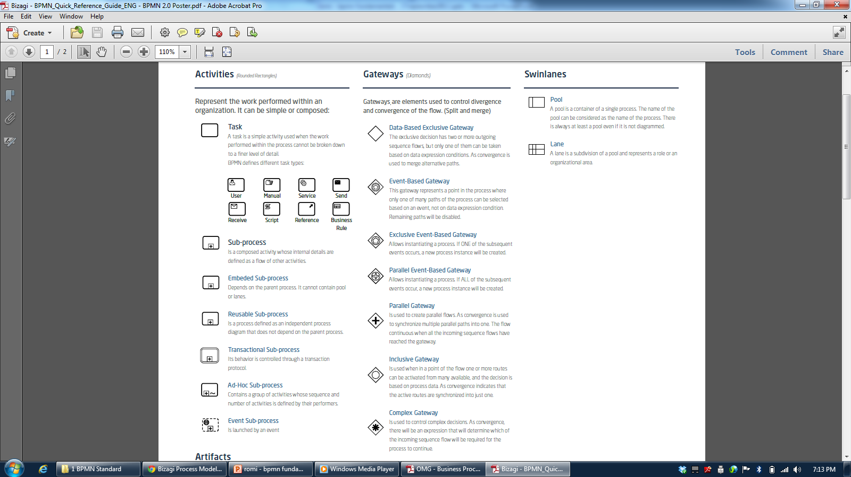
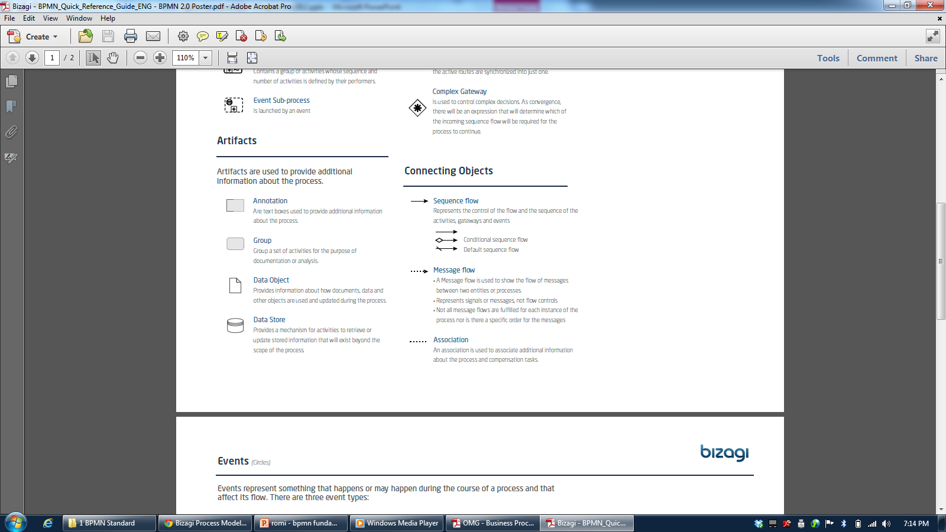
3

Slide 5
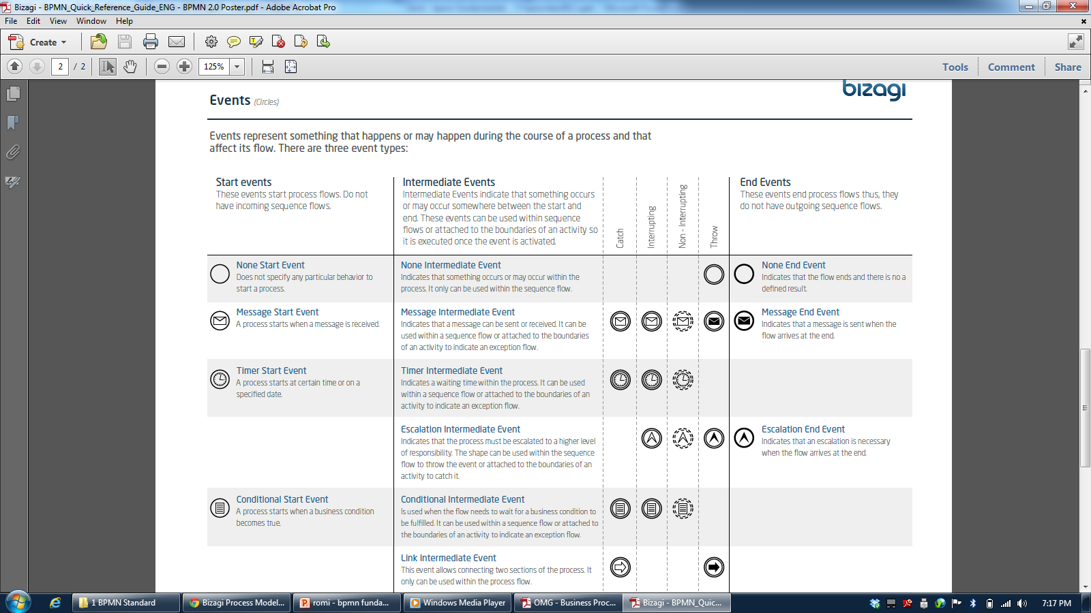
3

Slide 6
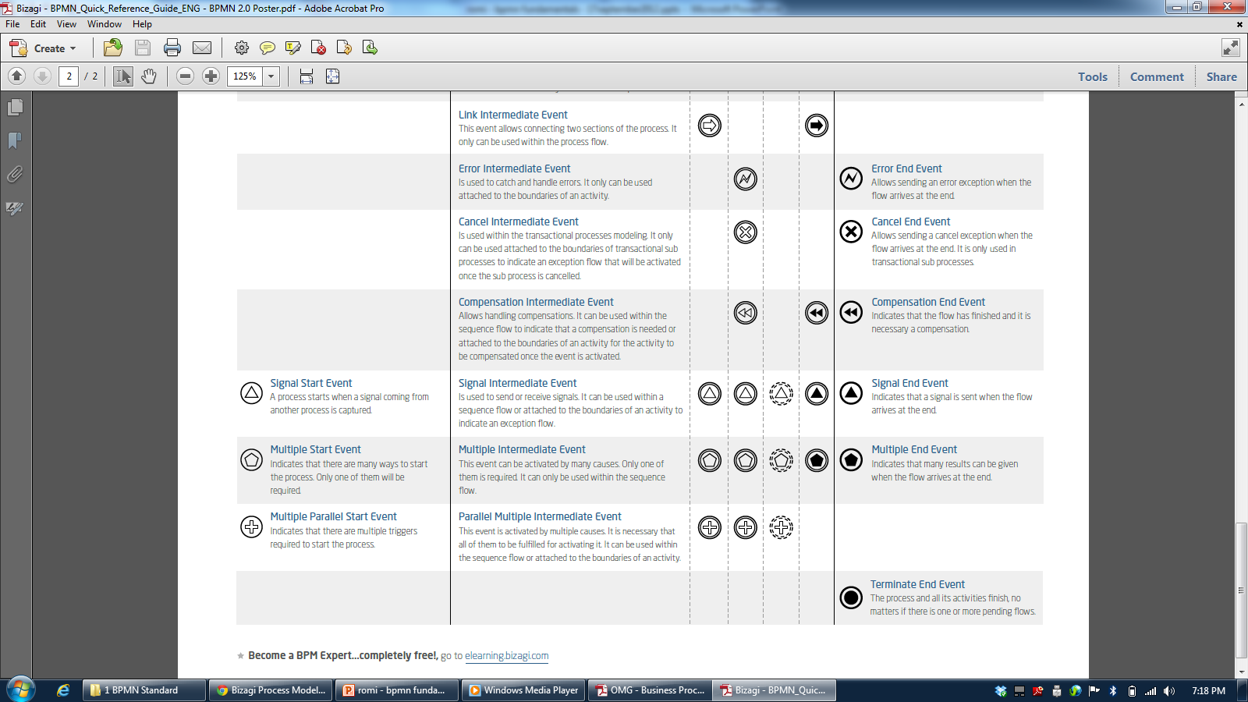
3

Slide 7
5.2 Bizagi BPMN Examples
7

Slide 8
Bizagi Process Templates
Account Payable
Change Management
Help Desk
Offboarding
Onboarding
Opportunity Management
Personal Loak request
Petition Claim Complaints
Purchase Request
Recruitment and Selection
Six Sigma Project Management
Travel Request
Vacation Request
Vehicle Insurance
<number>

Slide 9
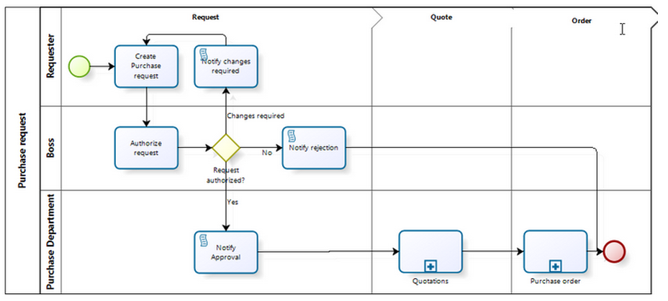
Purchase Request
<number>

Slide 10
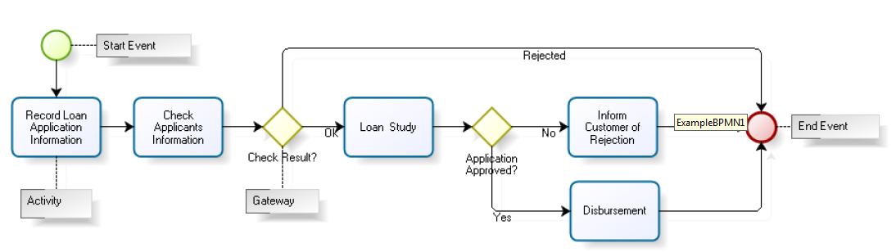
Credit Application
<number>

Slide 11
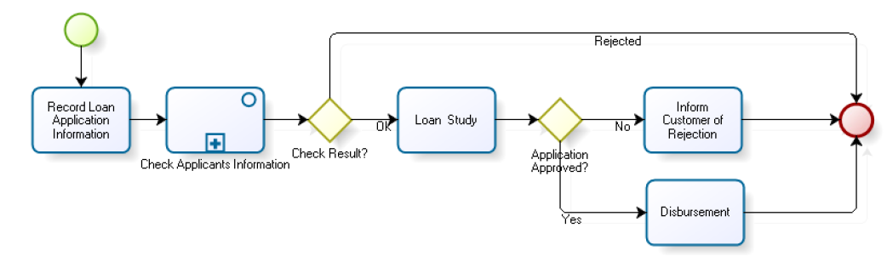
Credit Application with Subprocess
<number>

Slide 12
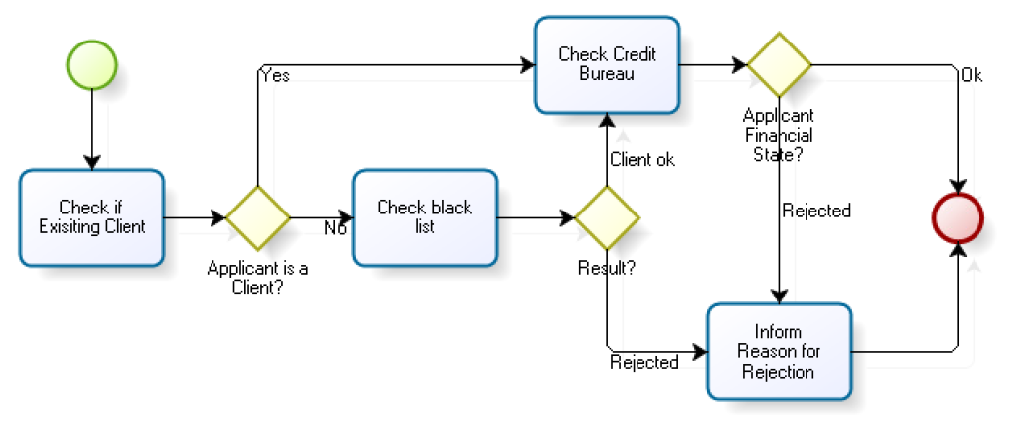
Information Checking Subprocess
<number>

Slide 13
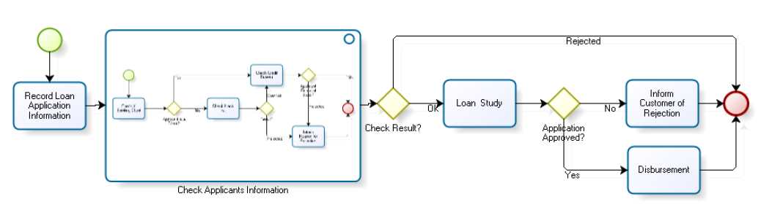
Credit Application with Expanded Subprocess
<number>

Slide 14
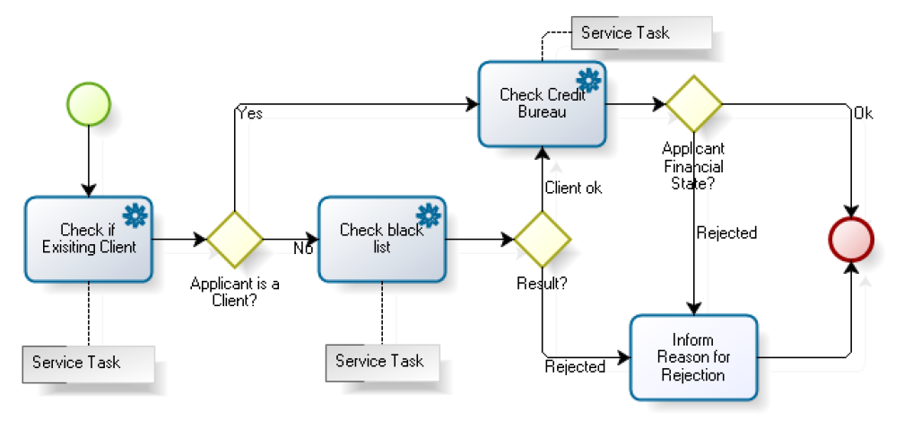
Information Checking with Automatic Activities
<number>

Slide 15
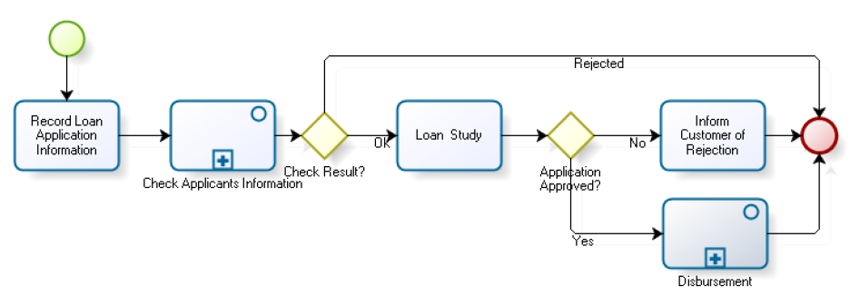
Credit Application with Subprocess (Disbursement)
<number>

Slide 16
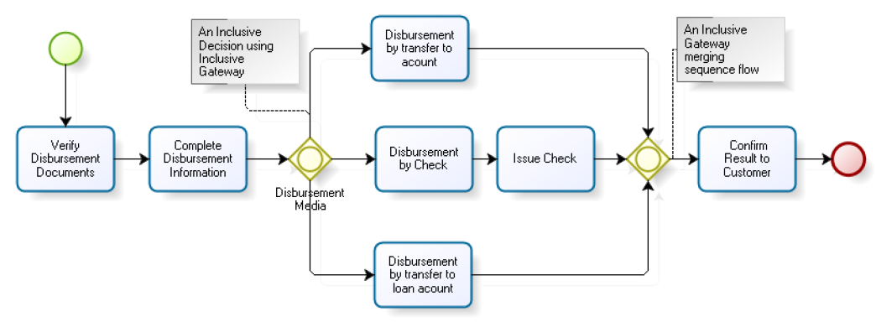
Disbursement Subprocess
<number>

Slide 17
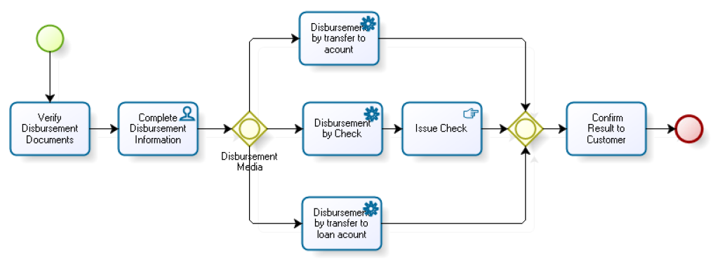
Disbursement with Some Type of Tasks
<number>

Slide 18
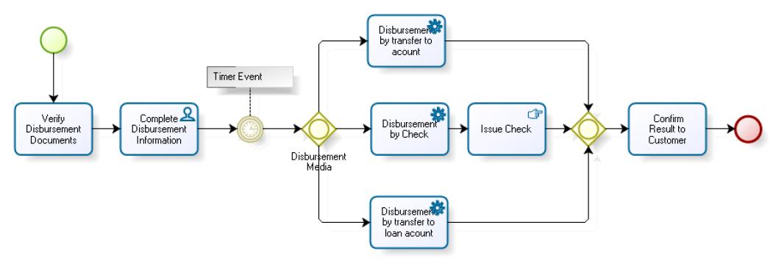
Disbursement with Timer
<number>

Slide 19
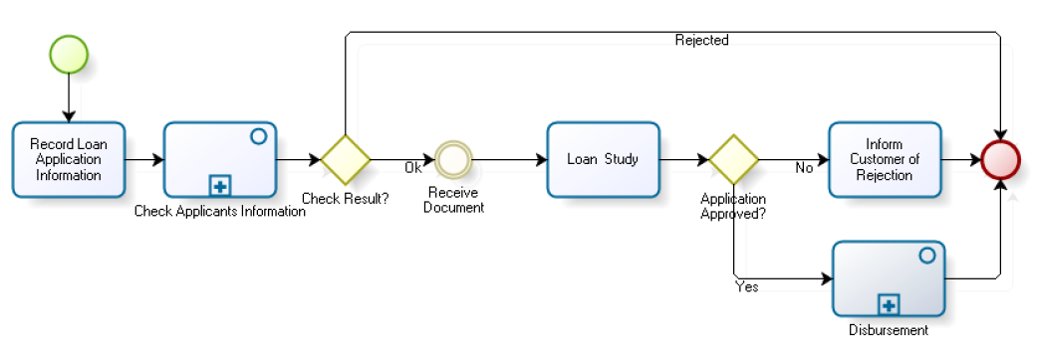
Credit Application with Simple Intermediate Event
<number>

Slide 20
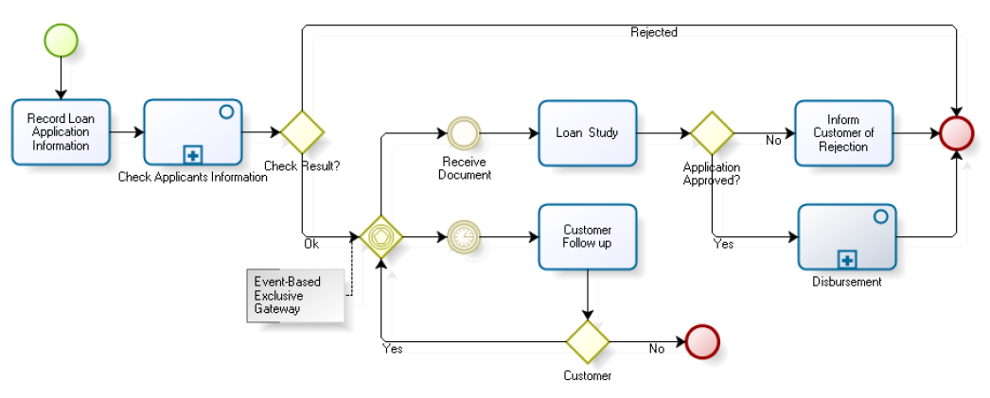
Credit Application with Simple Intermediate Event
<number>

Slide 21
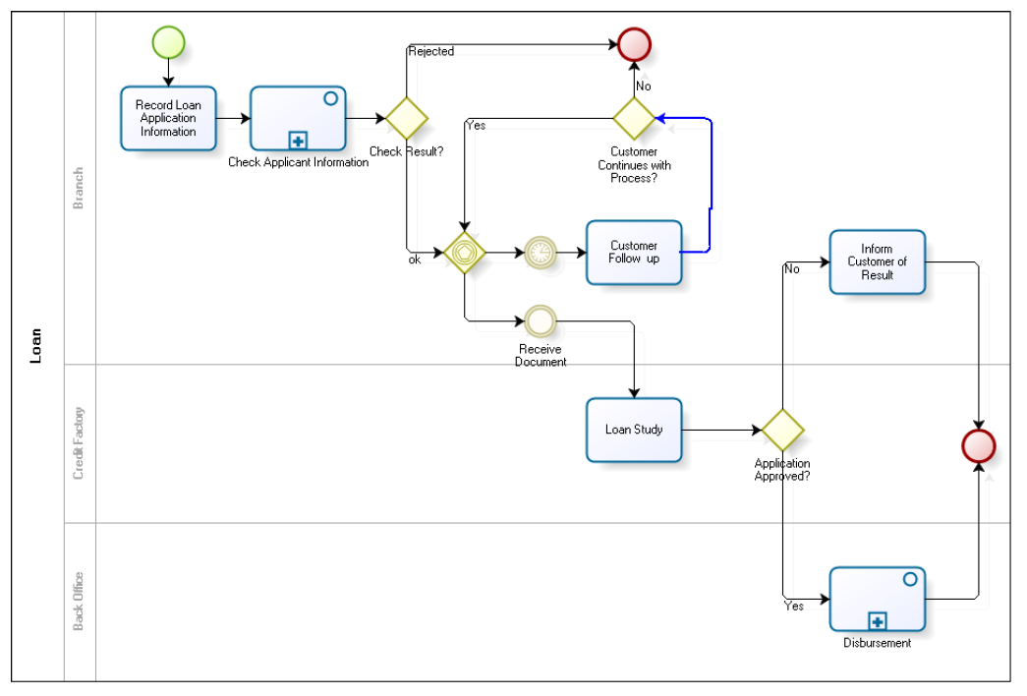
Credit Application (Final Version)
<number>

Slide 22
5.3 OMG BPMN Guide
<number>
Notes:
<number>

Slide 23
BPMN Elements
Core Set of Diagram Elements
Complete Set of Diagram Elements
<number>
Notes:
<number>

Slide 24
Core Set of Diagram Elements
The core set of modeling elements enable the easy development simple Business Process Diagrams that will look familiar to most Business Analysts (a flowchart diagram)
<number>
Notes:
<number>

Slide 25
Complete Set of Diagram Elements: Events
An Event is something that “happens” during the course of a business process
These Events affect the flow of the Process and usually have a trigger or a result
They can start, interrupt, or end the flow
<number>
Notes:
<number>

Slide 26
Complete Set of Diagram Elements: Activities
An activity is work that is performed within a business process
An activity can be atomic or non-atomic (compound)
The types of activities that are a part of a Process Model are:
Process
Sub-Process
Task
<number>
Notes:
<number>

Slide 27
Complete Set of Diagram Elements: Activities
A Sub-Process can be in an expanded form that shows the process details of the a lower-level set of activities
<number>
Notes:
<number>

Slide 28
Complete Set of Diagram Elements: Connections
A Sequence Flow is used to show the order that activities will be performed in a Process
A Message Flow is used to show the flow of messages between two entities that are prepared to send and receive them
An Association is used to associate information and artifacts with flow objects
<number>
Notes:
<number>

Slide 29
Complete Set of Diagram Elements: Gateways
Gateways are modeling elements that are used to control how Sequence Flows interact as they converge and diverge within a Process
If the flow does not need to be controlled, then a Gateway is not needed
<number>
Notes:
<number>

Slide 30
Complete Set of Diagram Elements: Swimlanes
A Pool is a “swimlane” and a graphical container for partitioning a set of activities from other Pools, usually in the context of B2B situations
A Lane is a sub-partition within a Pool and will extend the entire length of the Pool, either vertically or horizontally
<number>
Notes:
<number>

Slide 31
Complete Set of Diagram Elements: Artifacts
Data Objects are not flow objects (i.e., connected through Sequence Flow), but they do provide information about how documents, data, and other objects are used and updated within a Process
Text Annotations are a mechanism for a modeler to provide additional information for the reader of a BPMN diagram
Groups provide a mechanism to visually organize activities
<number>
Notes:
<number>

Slide 32
5.4 OMG BPMN Examples
<number>

Slide 33
OMG BPMN Examples
Email voting
Hardware Retailer
Incidement Management
Novel Prize
Order Fullfillment
Pizza Order
Travel Booking
<number>

Slide 34
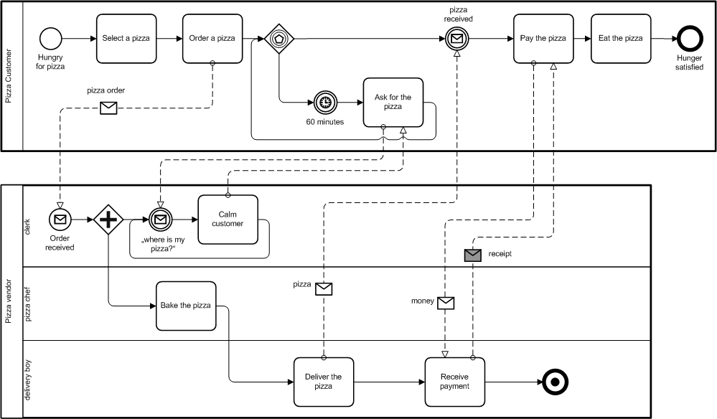
The Pizza Collaboration
<number>

Slide 35
Reference
Object Management Group, Business Process Model and Notation (BPMN), OMG Document Number: formal/2011-01-04, 2011
Object Management Group, BPMN 2.0 by Example, OMG Document Number: dtc/2010-06-02, 2011
Bruce Silver, BPMN Method and Style Second Edition, Cody-Cassidy Press, 2011
Layna Fischer (edt.), BPMN 2.0 Handbook Second Edition, Future Strategies, 2012
Tom Debevoise, Rick Geneva, and Richard Welke, The Microguide to Process Modeling in BPMN 2.0 Second Edition, CreateSpace, 2011
Bizagi Proses Modeler User Guide, Bizagi, 2012
Bizagi BPM Suite User Guide, Bizagi, 2013
Thomas Allweyer, BPMN 2.0, BoD, 2010
http://romisatriawahono.net/bpmn
<number>

